Slide 1
Deadlock Case - 1
flow 2
S2
rx
tx
L1
L2
flow 1
S1
S3
tx
rx
flow 3
rx
tx
L3
3-switch 3-flow case, each flow traverses 3 switches.

Slide 2
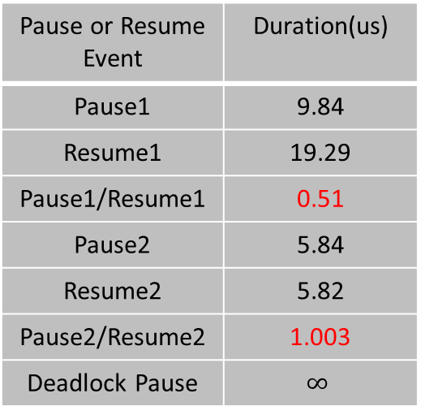
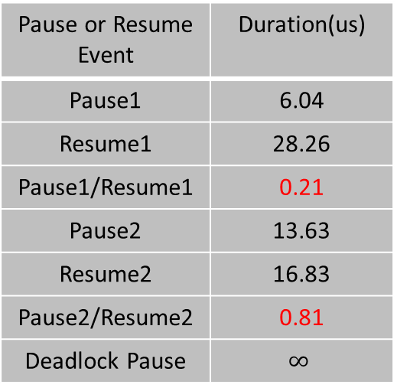
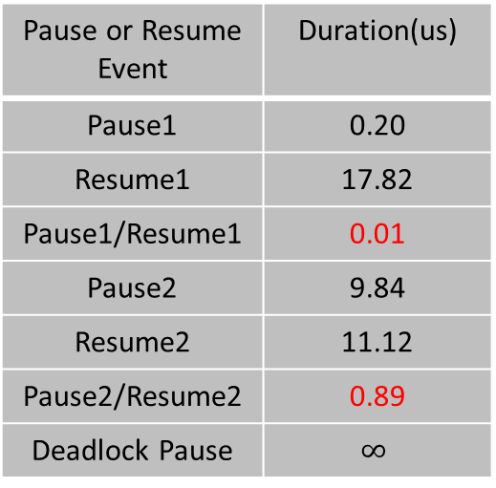
Pattern of Pause Events
Pause or Resume Event | Duration(us)
Pause1 | 6.04
Resume1 | 28.26
Pause1/Resume1 | 0.21
Pause2 | 13.63
Resume2 | 16.83
Pause2/Resume2 | 0.81
Deadlock Pause | $$∞$$
Pause or Resume Event | Duration(us)
Pause1 | 9.84
Resume1 | 19.29
Pause1/Resume1 | 0.51
Pause2 | 5.84
Resume2 | 5.82
Pause2/Resume2 | 1.003
Deadlock Pause | $$∞$$
Pause or Resume Event | Duration(us)
Pause1 | 0.20
Resume1 | 17.82
Pause1/Resume1 | 0.01
Pause2 | 9.84
Resume2 | 11.12
Pause2/Resume2 | 0.89
Deadlock Pause | $$∞$$
Link L1
Link L2
Link L3
The ratio of pause duration increases before deadlock happens.

Slide 3
Deadlock Case - 2
Flow 3
r₂ = B
r₁ = B
S1
S2
Flow 1
tx
rx
rx
L1
tx
L4
L2
r₂ = B
tx-1
rx
S4
L3
S3
Flow 2
tx-2
rx
tx
In addition to Scenario 4, add one addition flow from S2 to S3.

Slide 4
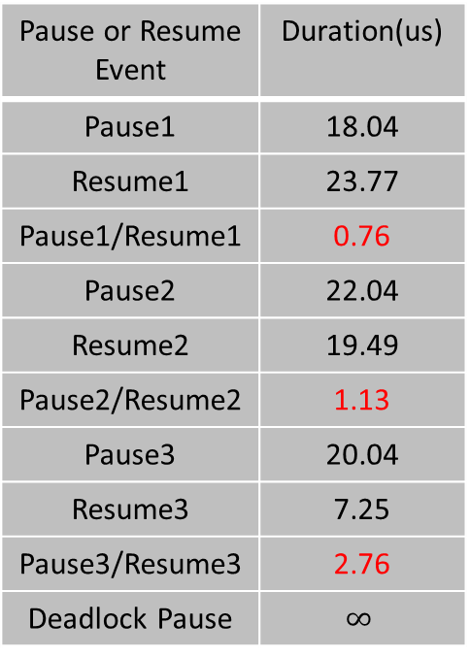
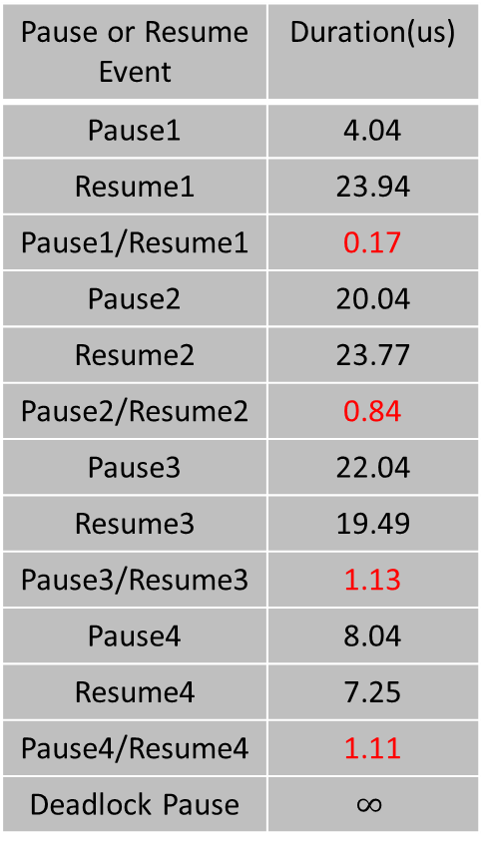
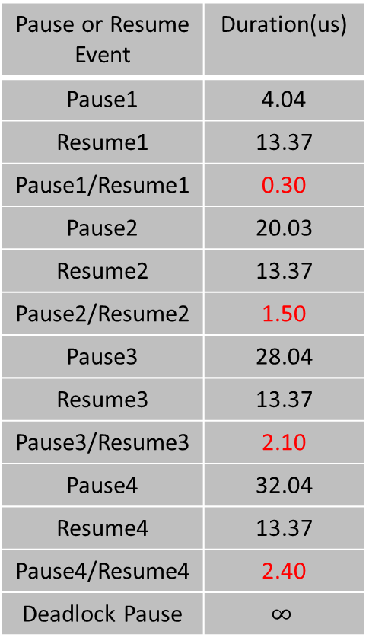
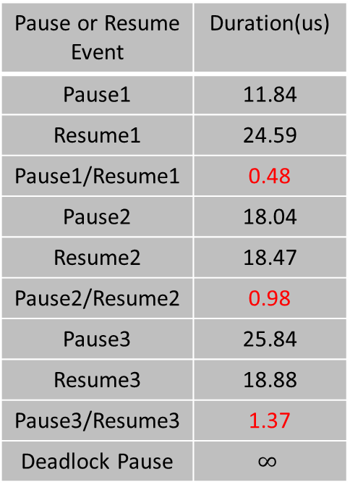
Pattern of Pause Events
Pause or Resume Event | Duration(us)
Pause1 | 4.04
Resume1 | 23.94
Pause1/Resume1 | 0.17
Pause2 | 20.04
Resume2 | 23.77
Pause2/Resume2 | 0.84
Pause3 | 22.04
Resume3 | 19.49
Pause3/Resume3 | 1.13
Pause4 | 8.04
Resume4 | 7.25
Pause4/Resume4 | 1.11
Deadlock Pause | $$∞$$
Pause or Resume Event | Duration(us)
Pause1 | 18.04
Resume1 | 23.77
Pause1/Resume1 | 0.76
Pause2 | 22.04
Resume2 | 19.49
Pause2/Resume2 | 1.13
Pause3 | 20.04
Resume3 | 7.25
Pause3/Resume3 | 2.76
Deadlock Pause | $$∞$$
Pause or Resume Event | Duration(us)
Pause1 | 11.84
Resume1 | 24.59
Pause1/Resume1 | 0.48
Pause2 | 18.04
Resume2 | 18.47
Pause2/Resume2 | 0.98
Pause3 | 25.84
Resume3 | 18.88
Pause3/Resume3 | 1.37
Deadlock Pause | $$∞$$
Pause or Resume Event | Duration(us)
Pause1 | 4.04
Resume1 | 13.37
Pause1/Resume1 | 0.30
Pause2 | 20.03
Resume2 | 13.37
Pause2/Resume2 | 1.50
Pause3 | 28.04
Resume3 | 13.37
Pause3/Resume3 | 2.10
Pause4 | 32.04
Resume4 | 13.37
Pause4/Resume4 | 2.40
Deadlock Pause | $$∞$$
Link L2
Link L3
The ratio of pause duration increases before deadlock happens.
Link L1
Link L4

Slide 5
Deadlock Case - 3
Flow 2
Flow 1
S1
S2
tx
rx
rx
L1
tx
L4
L2
tx-1
L3
rx
S4
S3
tx-2
rx
tx
Flow 3
Flow 4
4-switch 4-flow case, each flow traverses 3 switches.

Slide 6
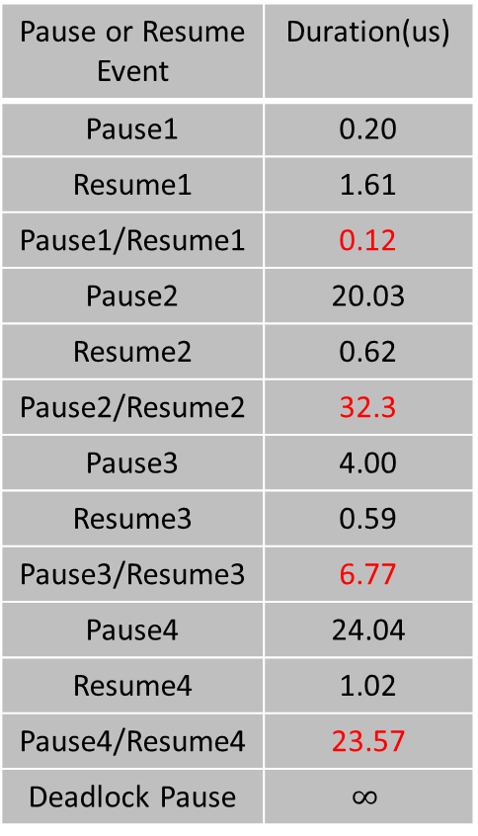
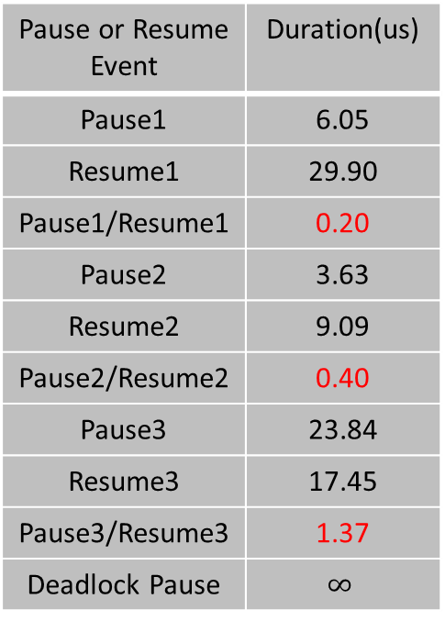
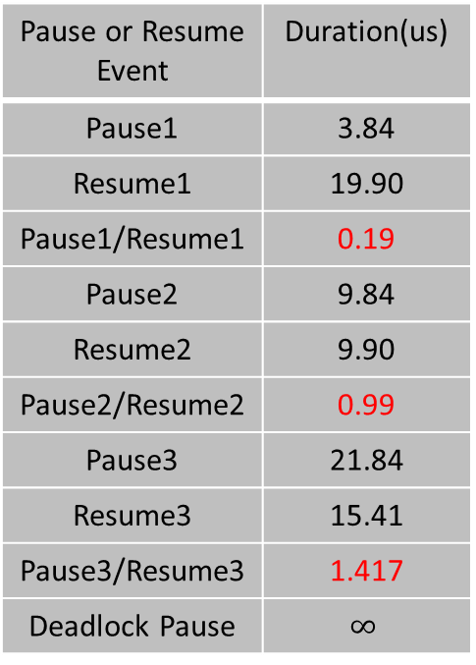
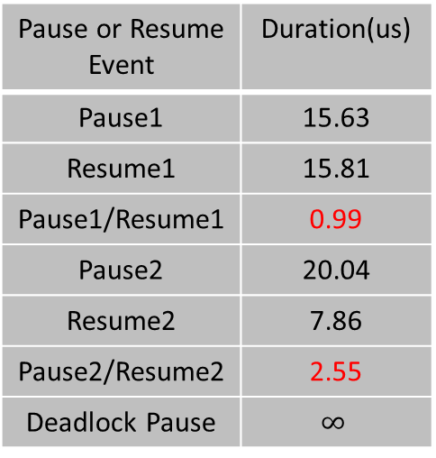
Pattern of Pause Events
Pause or Resume Event | Duration(us)
Pause1 | 6.05
Resume1 | 29.90
Pause1/Resume1 | 0.20
Pause2 | 3.63
Resume2 | 9.09
Pause2/Resume2 | 0.40
Pause3 | 23.84
Resume3 | 17.45
Pause3/Resume3 | 1.37
Deadlock Pause | $$∞$$
Pause or Resume Event | Duration(us)
Pause1 | 0.20
Resume1 | 1.61
Pause1/Resume1 | 0.12
Pause2 | 20.03
Resume2 | 0.62
Pause2/Resume2 | 32.3
Pause3 | 4.00
Resume3 | 0.59
Pause3/Resume3 | 6.77
Pause4 | 24.04
Resume4 | 1.02
Pause4/Resume4 | 23.57
Deadlock Pause | $$∞$$
Pause or Resume Event | Duration(us)
Pause1 | 15.63
Resume1 | 15.81
Pause1/Resume1 | 0.99
Pause2 | 20.04
Resume2 | 7.86
Pause2/Resume2 | 2.55
Deadlock Pause | $$∞$$
Pause or Resume Event | Duration(us)
Pause1 | 3.84
Resume1 | 19.90
Pause1/Resume1 | 0.19
Pause2 | 9.84
Resume2 | 9.90
Pause2/Resume2 | 0.99
Pause3 | 21.84
Resume3 | 15.41
Pause3/Resume3 | 1.417
Deadlock Pause | $$∞$$
Link L3
Link L1
Link L4
Link L2
The ratio of pause duration increases before deadlock happens.

Slide 7
Non-Deadlock Case - 1
r₁ = B
S1
S2
Flow 1
tx
rx
rx
L1
tx
L4
L2
r₂ = B
tx-1
rx
S4
L3
S3
Flow 2
tx-2
rx
tx
4-switch 2-flow case

Slide 8
Pattern of Pause Events
Pause or Resume Event | Duration(us)
… | …
Pause1 | 6.04
Resume1 | 14.77
Pause1/Resume1 | 0.41
Pause2 | 6.04
Resume2 | 14.77
Pause2/Resume2 | 0.41
Pause3 | 6.04
Resume3 | 14.77
Pause3/Resume3 | 0.41
Pause4 | 6.04
Resume4 | 14.77
Pause4/Resume4 | 0.41
… | …
Pause or Resume Event | Duration(us)
… | …
Pause1 | 6.04
Resume1 | 14.77
Pause1/Resume1 | 0.41
Pause2 | 6.04
Resume2 | 14.77
Pause2/Resume2 | 0.41
Pause3 | 6.04
Resume3 | 14.77
Pause3/Resume3 | 0.41
Pause4 | 6.04
Resume4 | 14.77
Pause4/Resume4 | 0.41
… | …
Link L2
Link L4
The ratio of pause duration converges into a fixed value.

Slide 9
Non-Deadlock Case - 2
r₁ = B
Flow 3, rate limited at circle link to 1/4
S1
S2
Flow 1
tx
rx
rx
L1
tx
L4
L2
r₂ = B
tx-1
rx
S4
L3
S3
Flow 2
tx-2
rx
tx
Flow 4, rate limited at circle link to 1/4
4-switch 4-flow case

Slide 10
Pattern of Pause Events
Pause or Resume Event | Duration(us)
… | …
Pause1 | 4.04
Resume1 | 15.98
Pause1/Resume1 | 0.25
Pause2 | 2.41
Resume2 | 23.57
Pause2/Resume2 | 0.10
Pause3 | 4.04
Resume3 | 10.47
Pause3/Resume3 | 0.39
Pause4 | 1.01
Resume4 | 29.04
Pause4/Resume4 | 0.03
… | …
Pause or Resume Event | Duration(us)
… | …
Pause1 | 12.04
Resume1 | 9.29
Pause1/Resume1 | 1.30
Pause2 | 18.04
Resume2 | 7.05
Pause2/Resume2 | 2.56
Pause3 | 12.04
Resume3 | 9.29
Pause3/Resume3 | 1.30
Pause4 | 16.04
Resume4 | 7.04
Pause4/Resume4 | 2.28
… | …
Pause or Resume Event | Duration(us)
… | …
Pause1 | 2.04
Resume1 | 23.53
Pause1/Resume1 | 0.09
Pause2 | 2.61
Resume2 | 16.43
Pause2/Resume2 | 0.16
Pause3 | 2.61
Resume3 | 23.57
Pause3/Resume3 | 0.11
Pause4 | 2.61
Resume4 | 10.92
Pause4/Resume4 | 0.24
… | …
Pause or Resume Event | Duration(us)
… | …
Pause1 | 12.04
Resume1 | 9.29
Pause1/Resume1 | 1.30
Pause2 | 16.04
Resume2 | 7.04
Pause2/Resume2 | 2.28
Pause3 | 12.04
Resume3 | 9.29
Pause3/Resume3 | 1.30
Pause4 | 18.04
Resume4 | 7.04
Pause4/Resume4 | 2.56
… | …
Link L1
Link L2
Link L3
Link L4
The ratio of pause duration varies without obvious trend.

